Slide 1
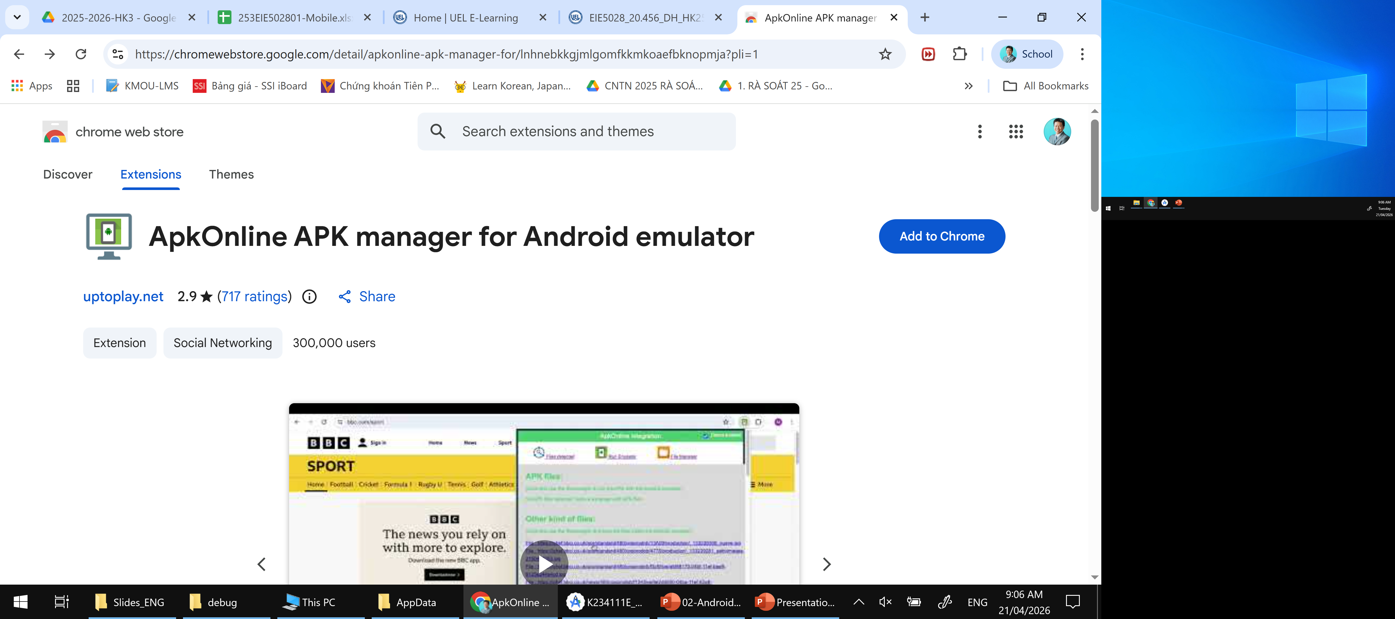
Chạy Android APK trên nền Chrome: ApkOnline APK manager for Android emulator
https://chromewebstore.google.com/detail/apkonline-apk-manager-for/lnhnebkkgjmlgomfkkmkoaefbknopmja?pli=1

Slide 2
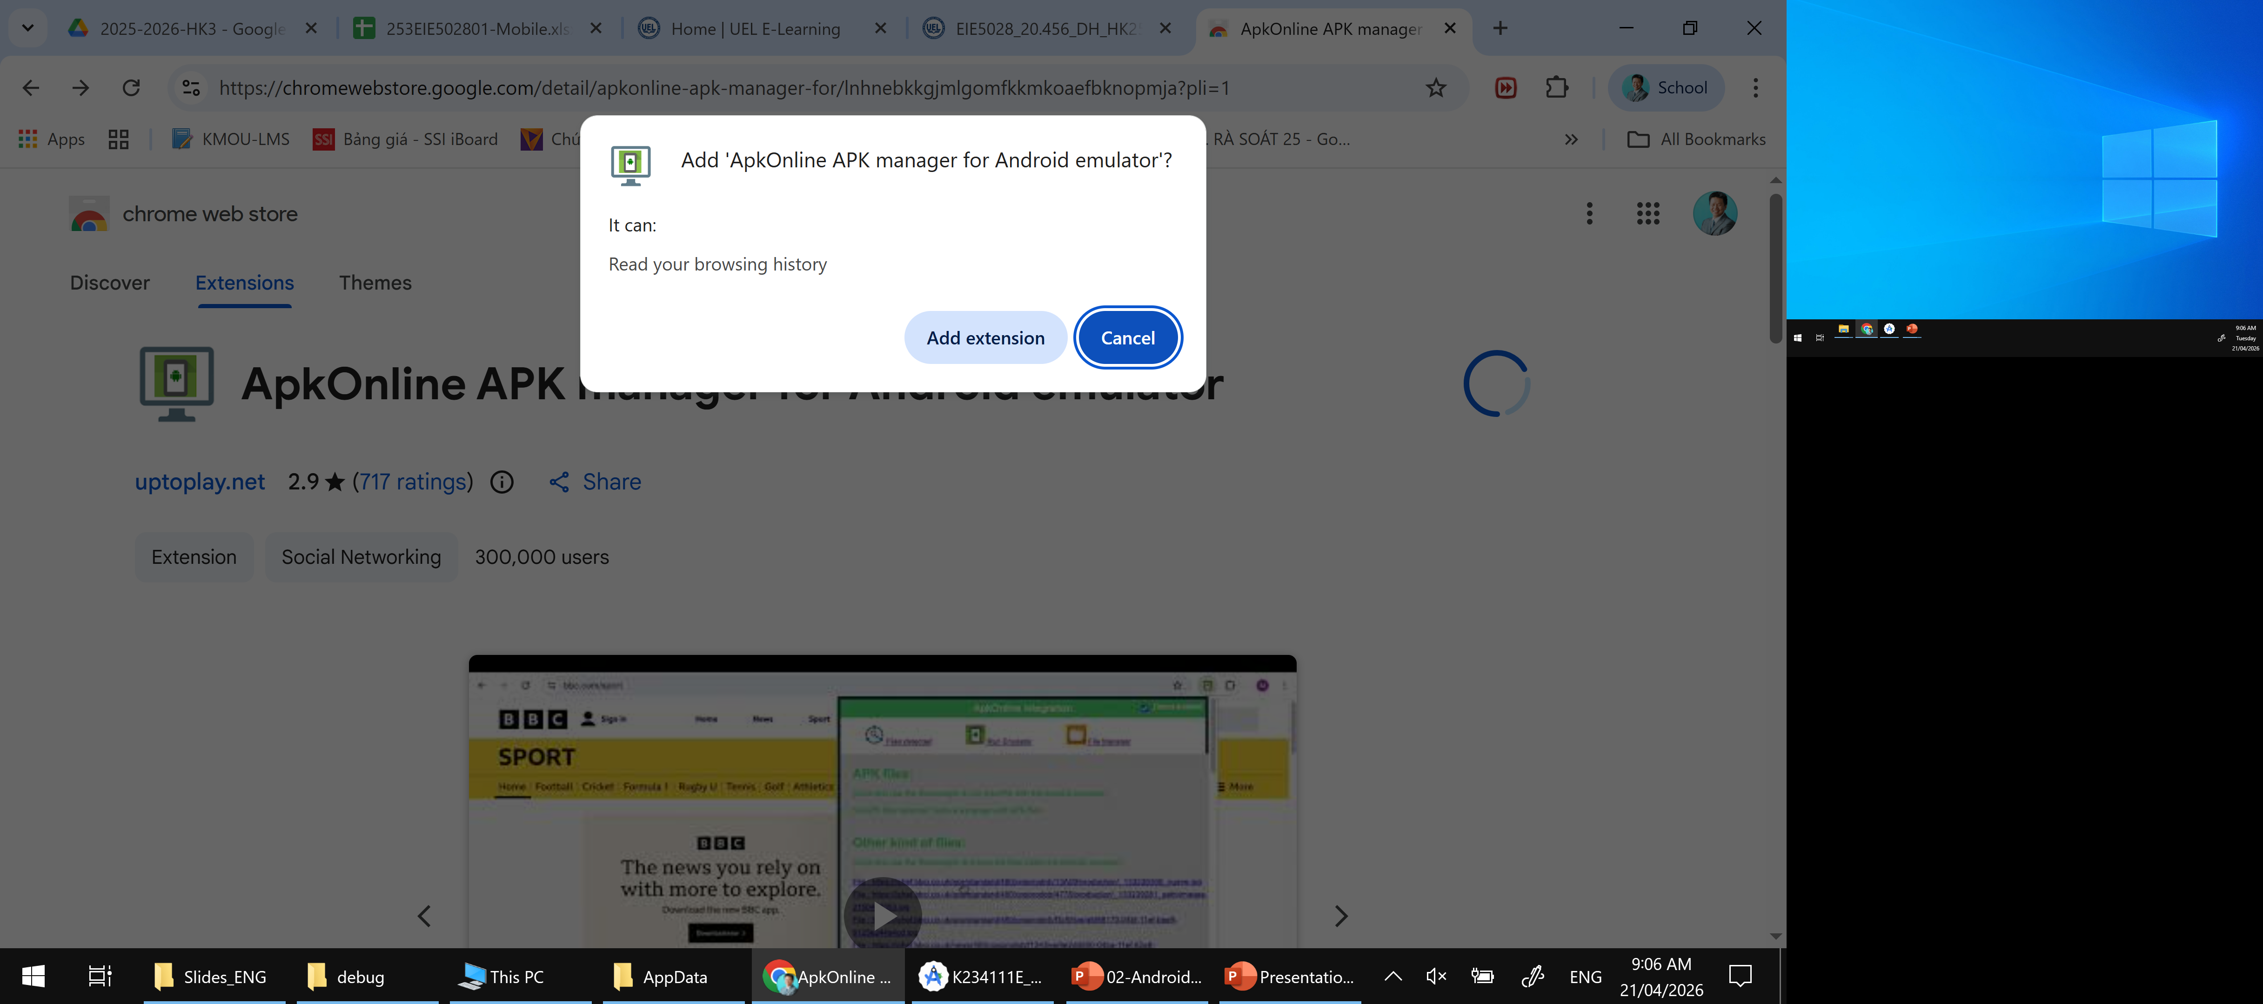

Slide 3
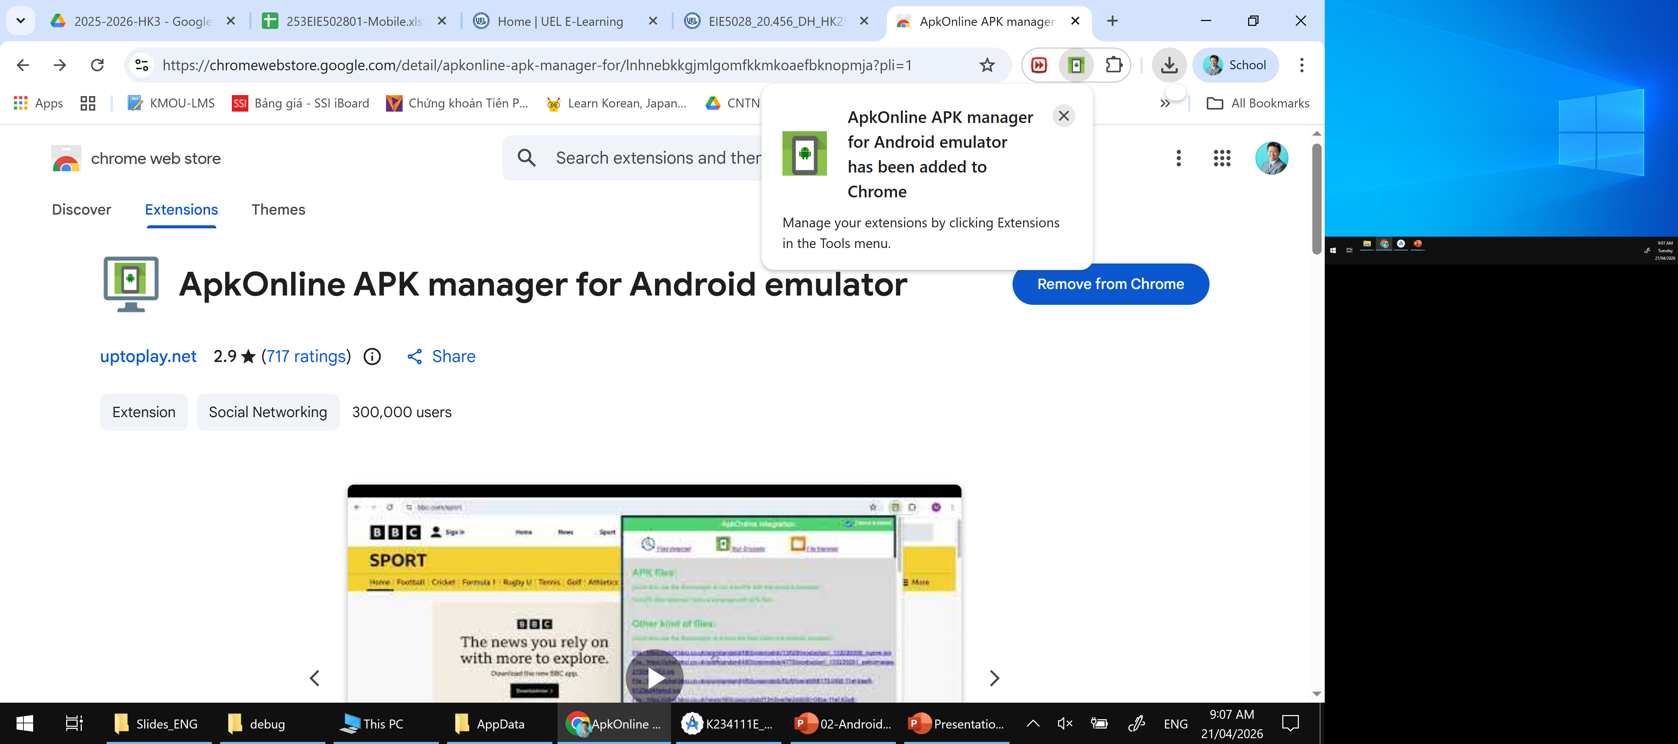

Slide 4
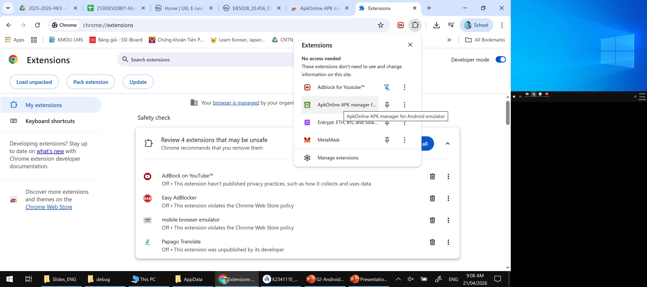

Slide 5
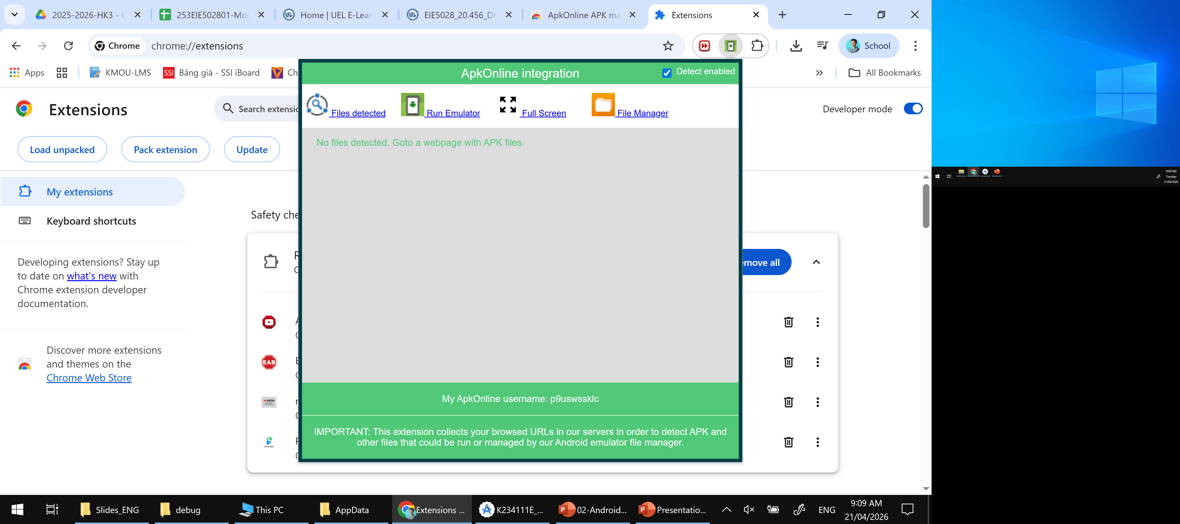

Slide 6
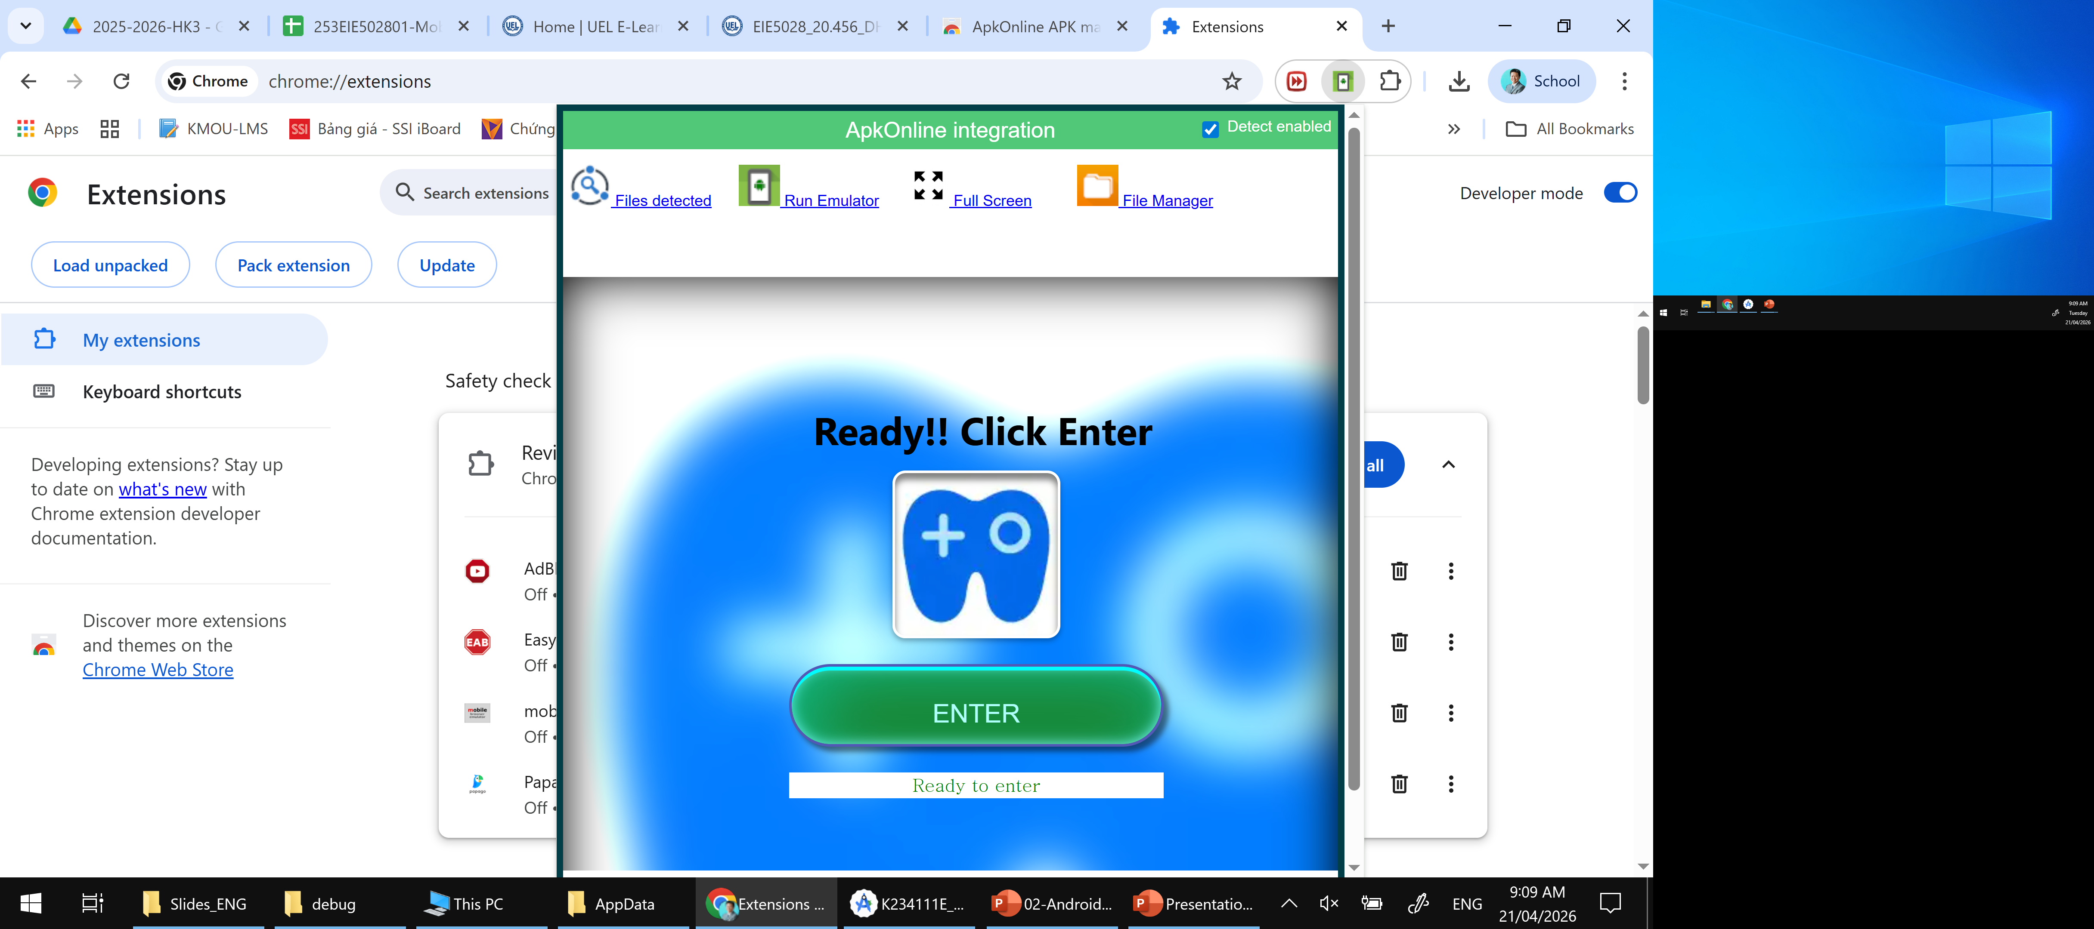

Slide 7
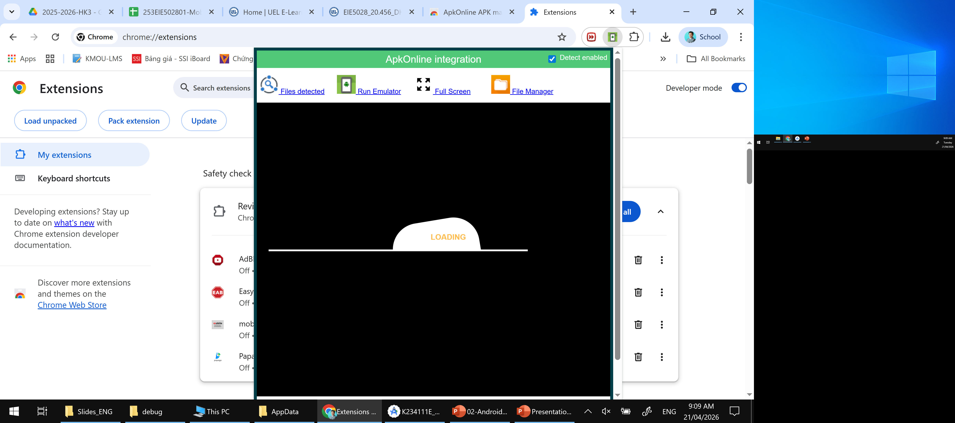

Slide 8
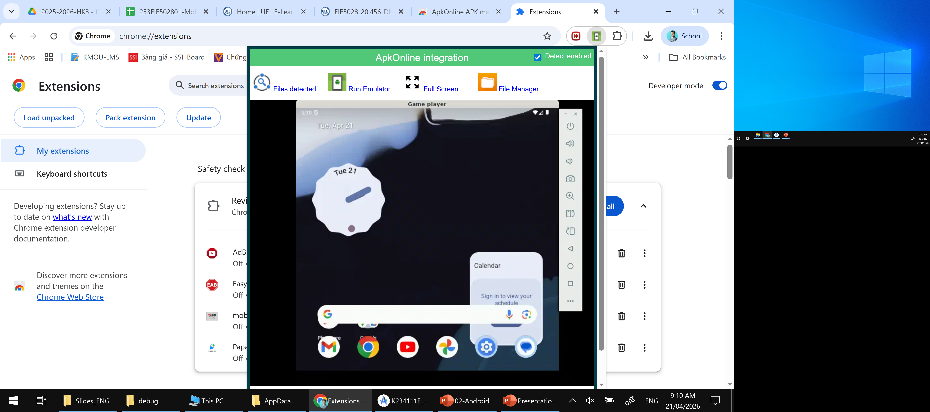

Slide 9
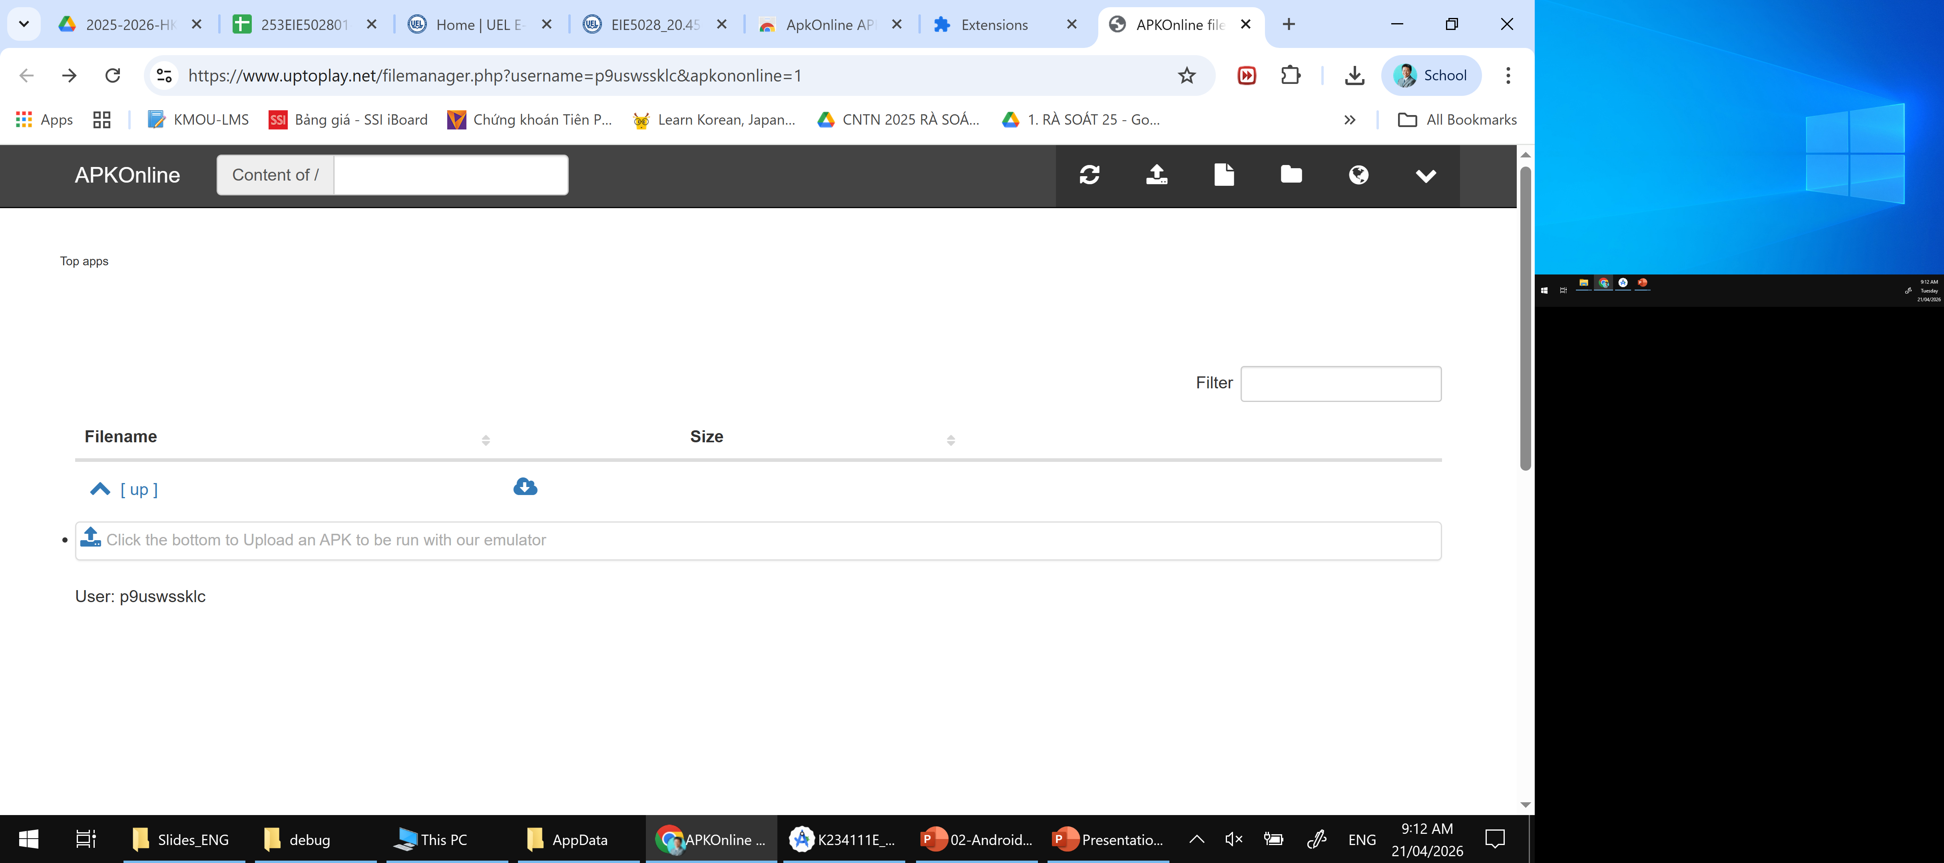
Chọn file manager

Slide 10
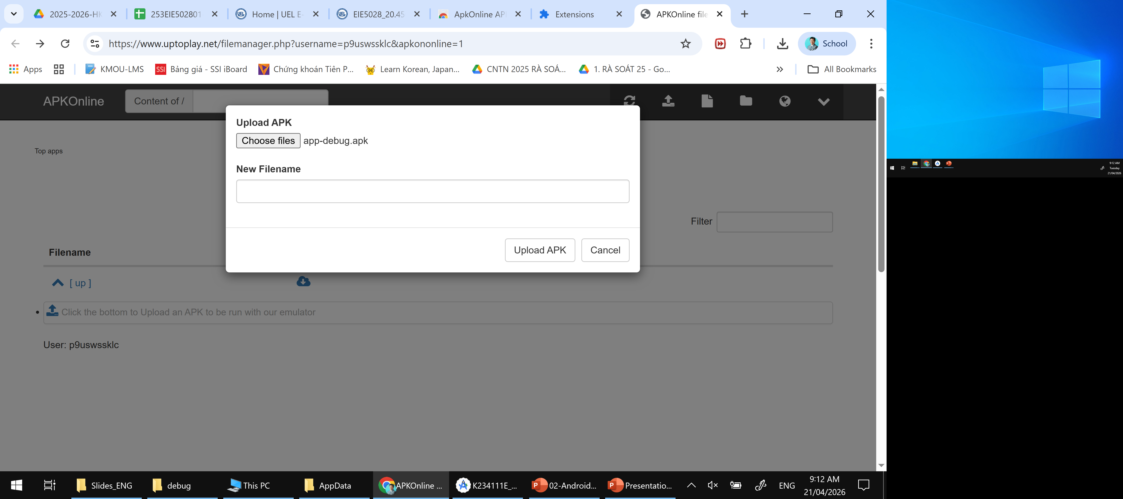

Slide 11
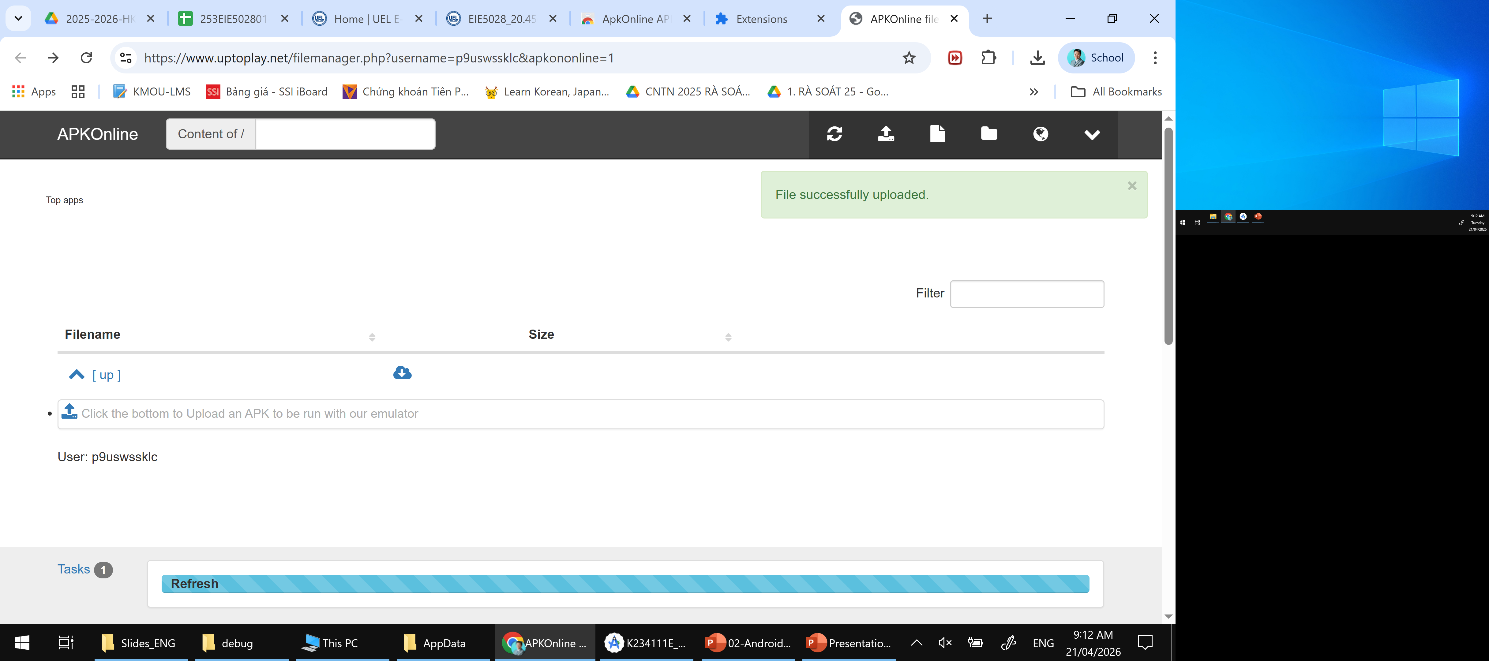

Slide 12


Slide 13
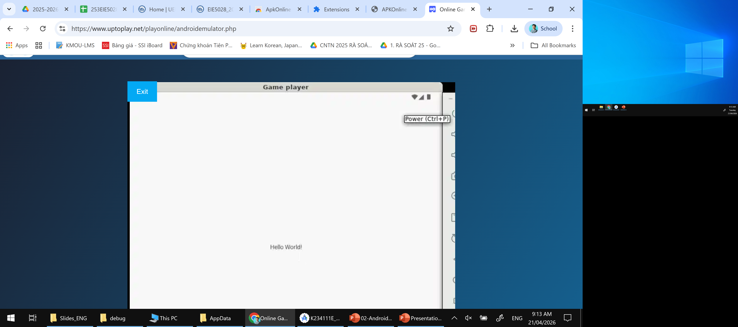
APK chạy ở đây -➔ Hello World

